Slide 1
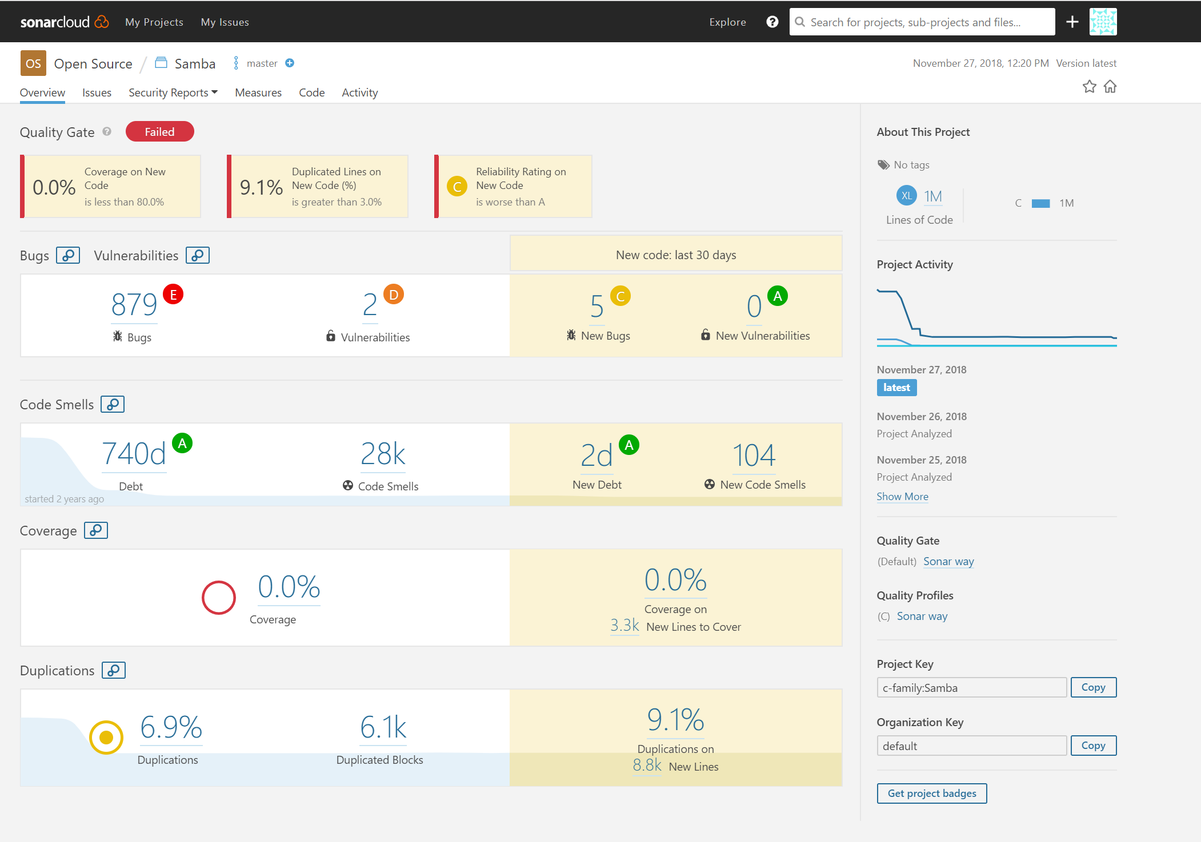
Security Analysis of Samba Using SonarQube Cloud

Slide 2
Security Analysis of Samba Using SonarQube Cloud

Slide 3
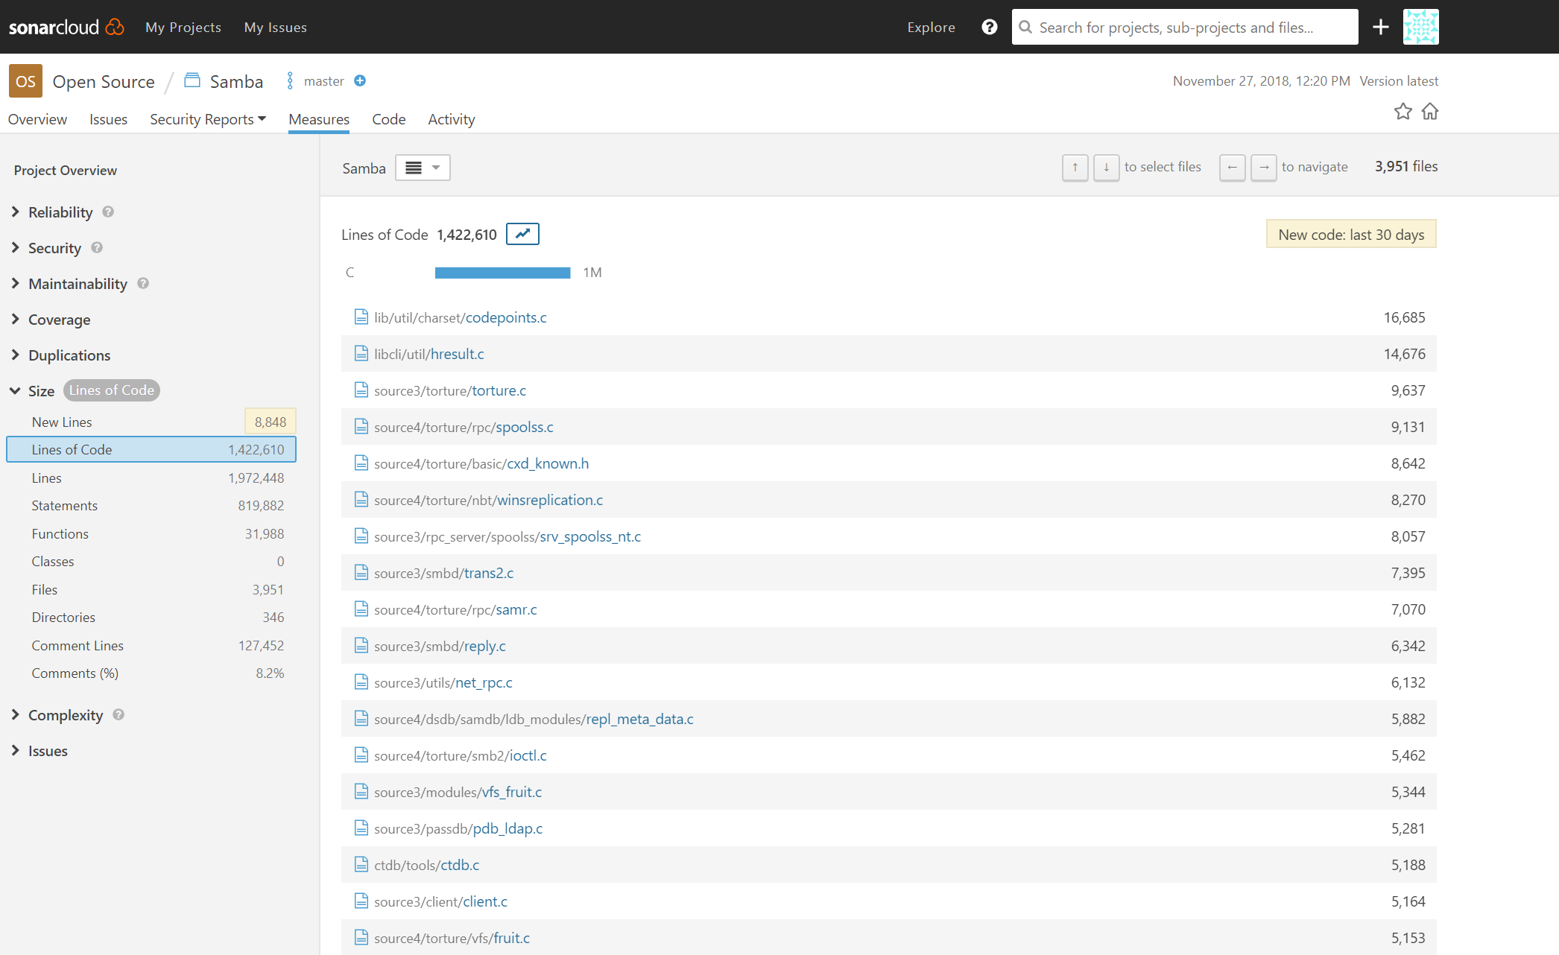
Security Analysis of Samba Using SonarQube Cloud

Slide 4
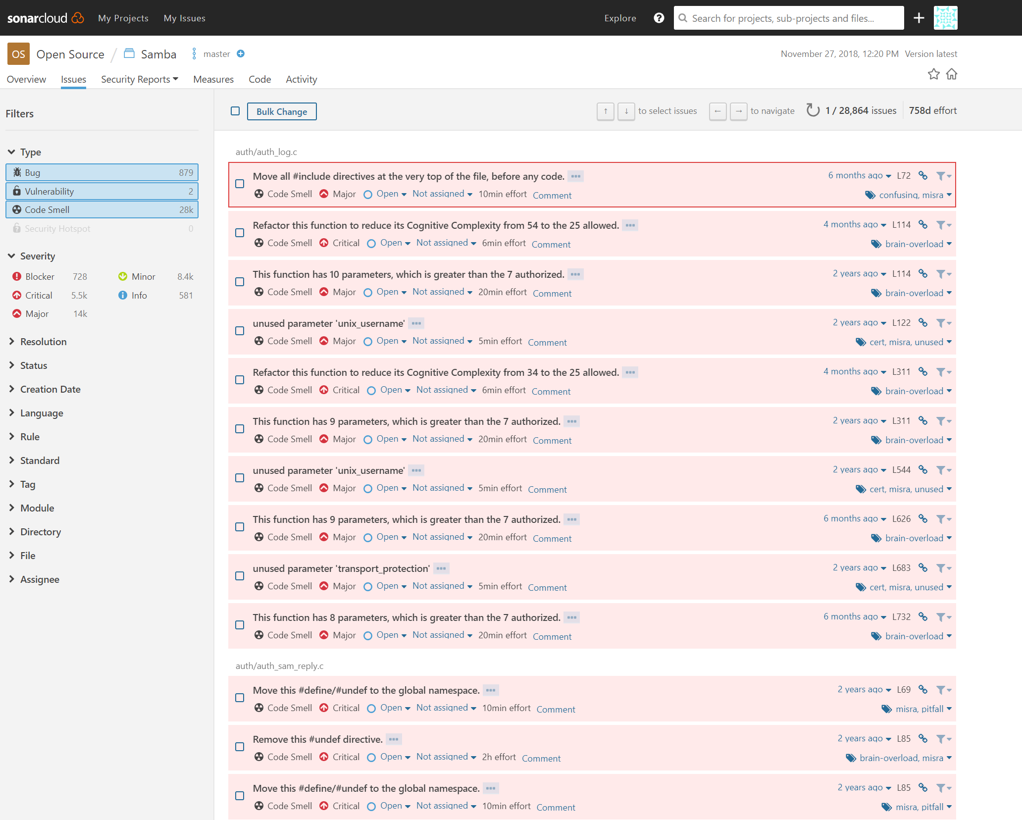

Slide 5
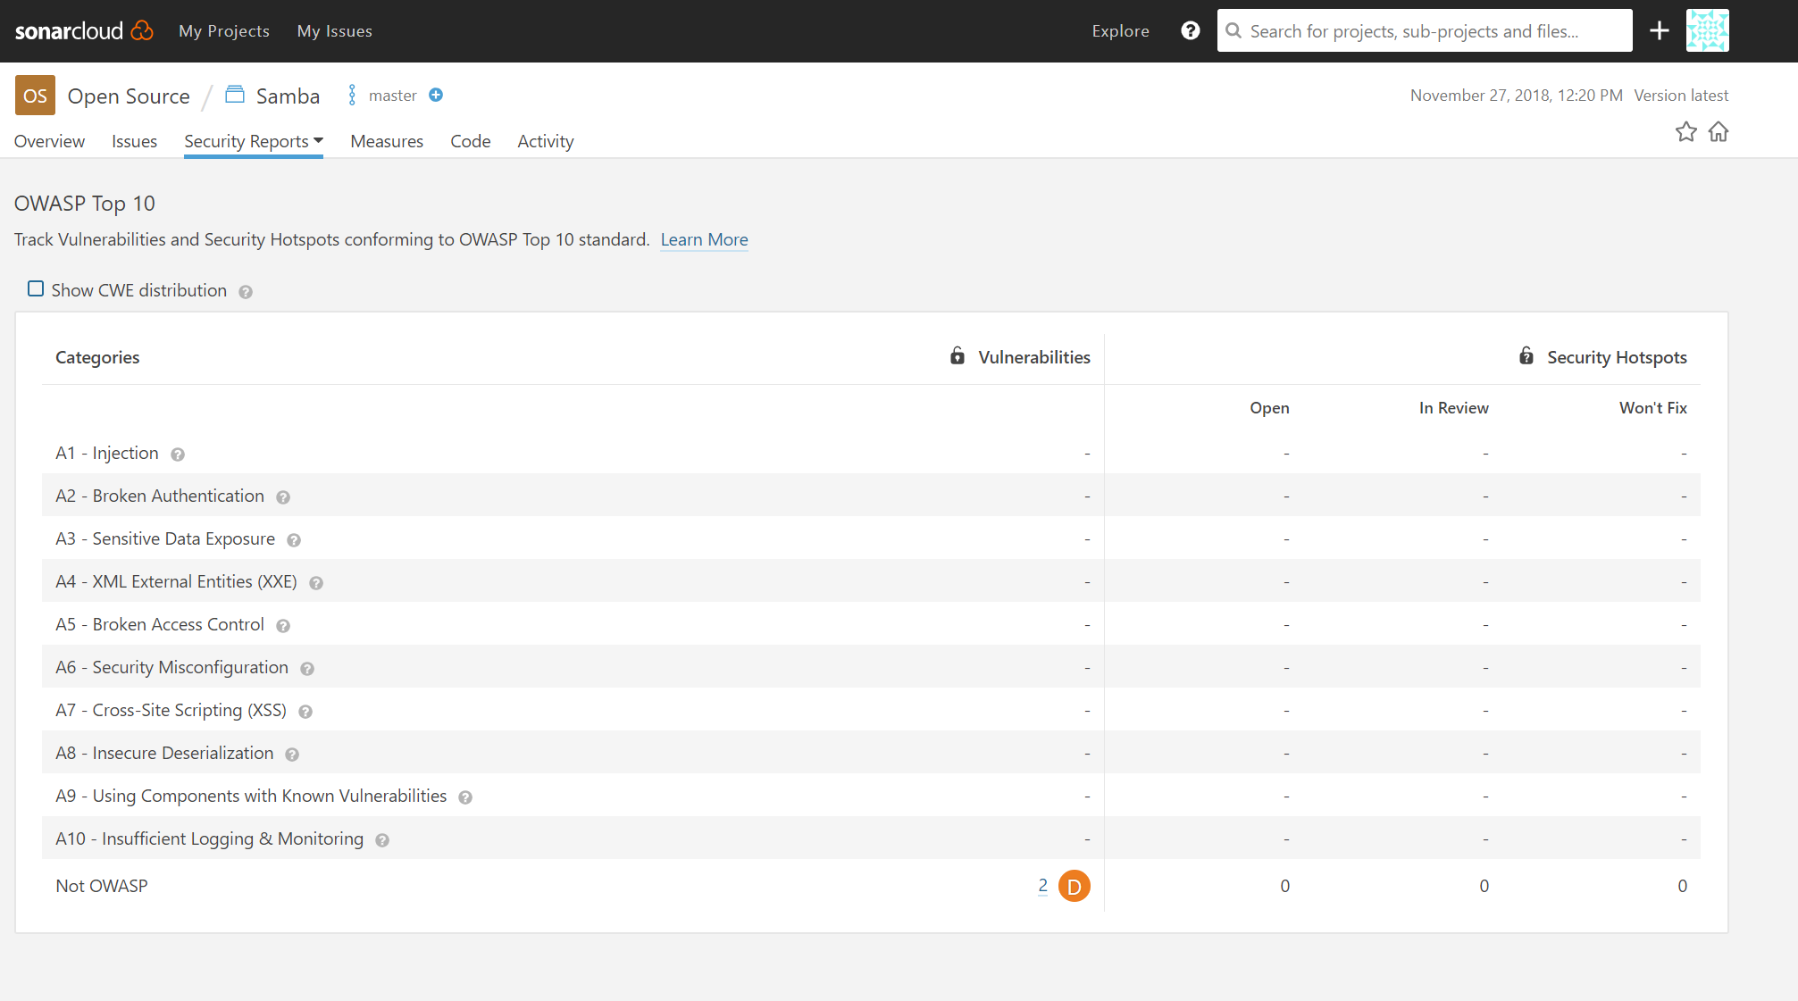

Slide 6
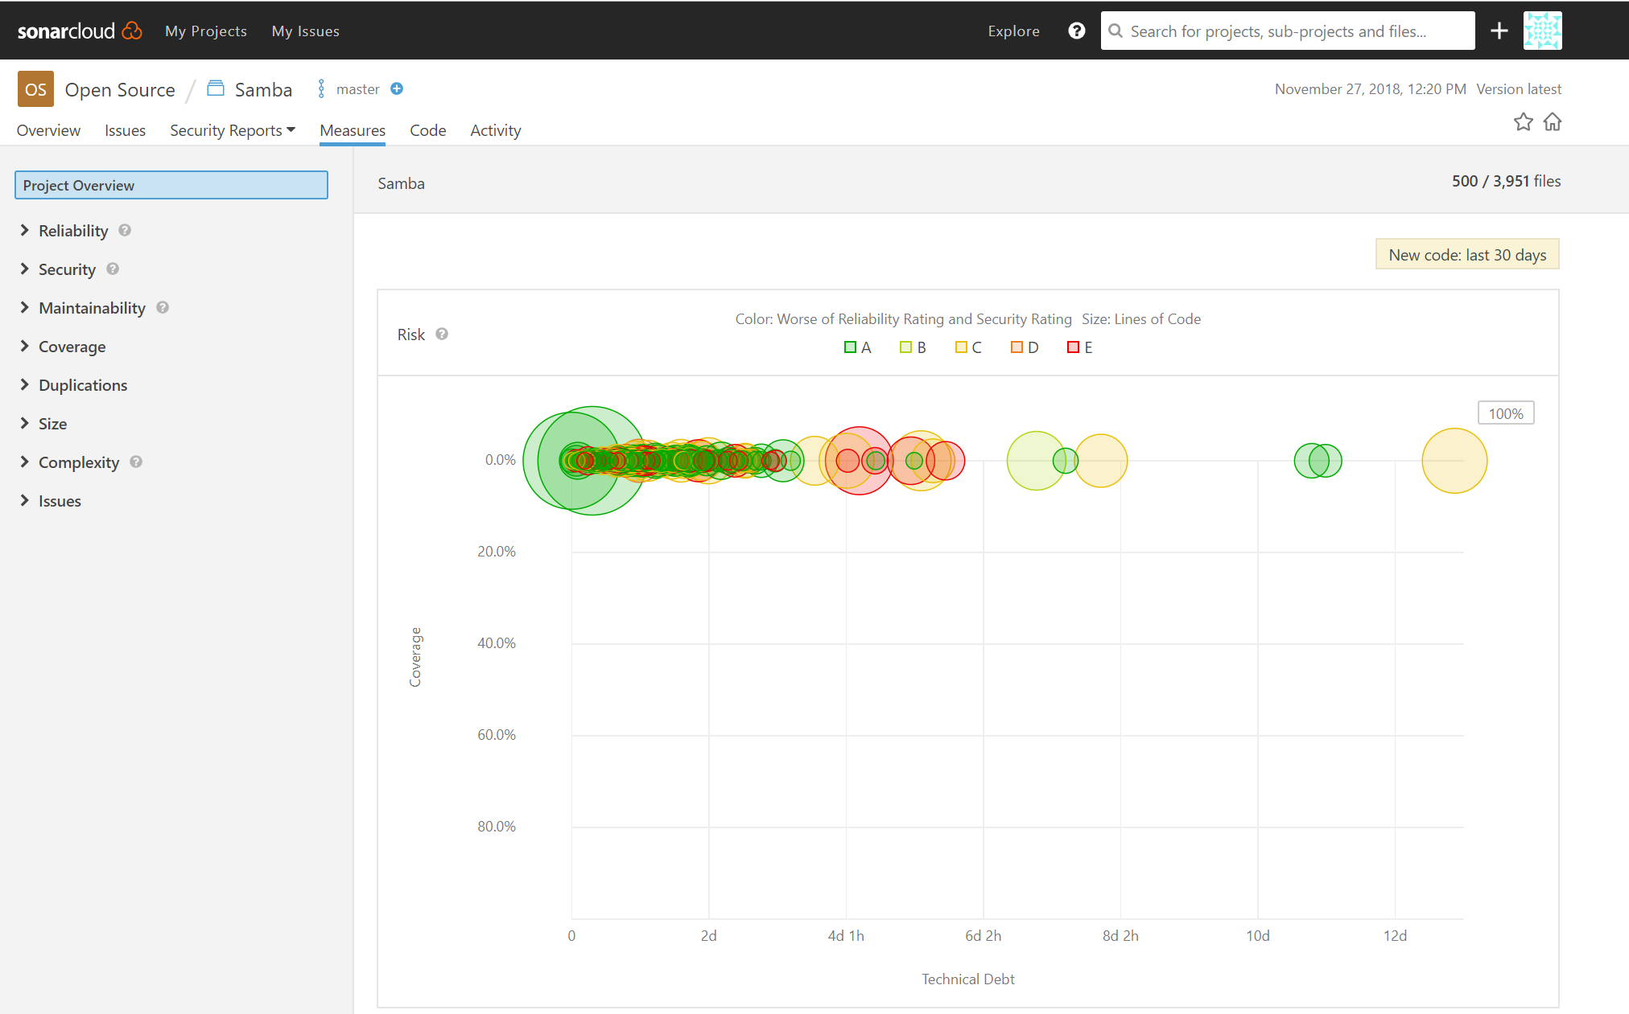

Slide 7
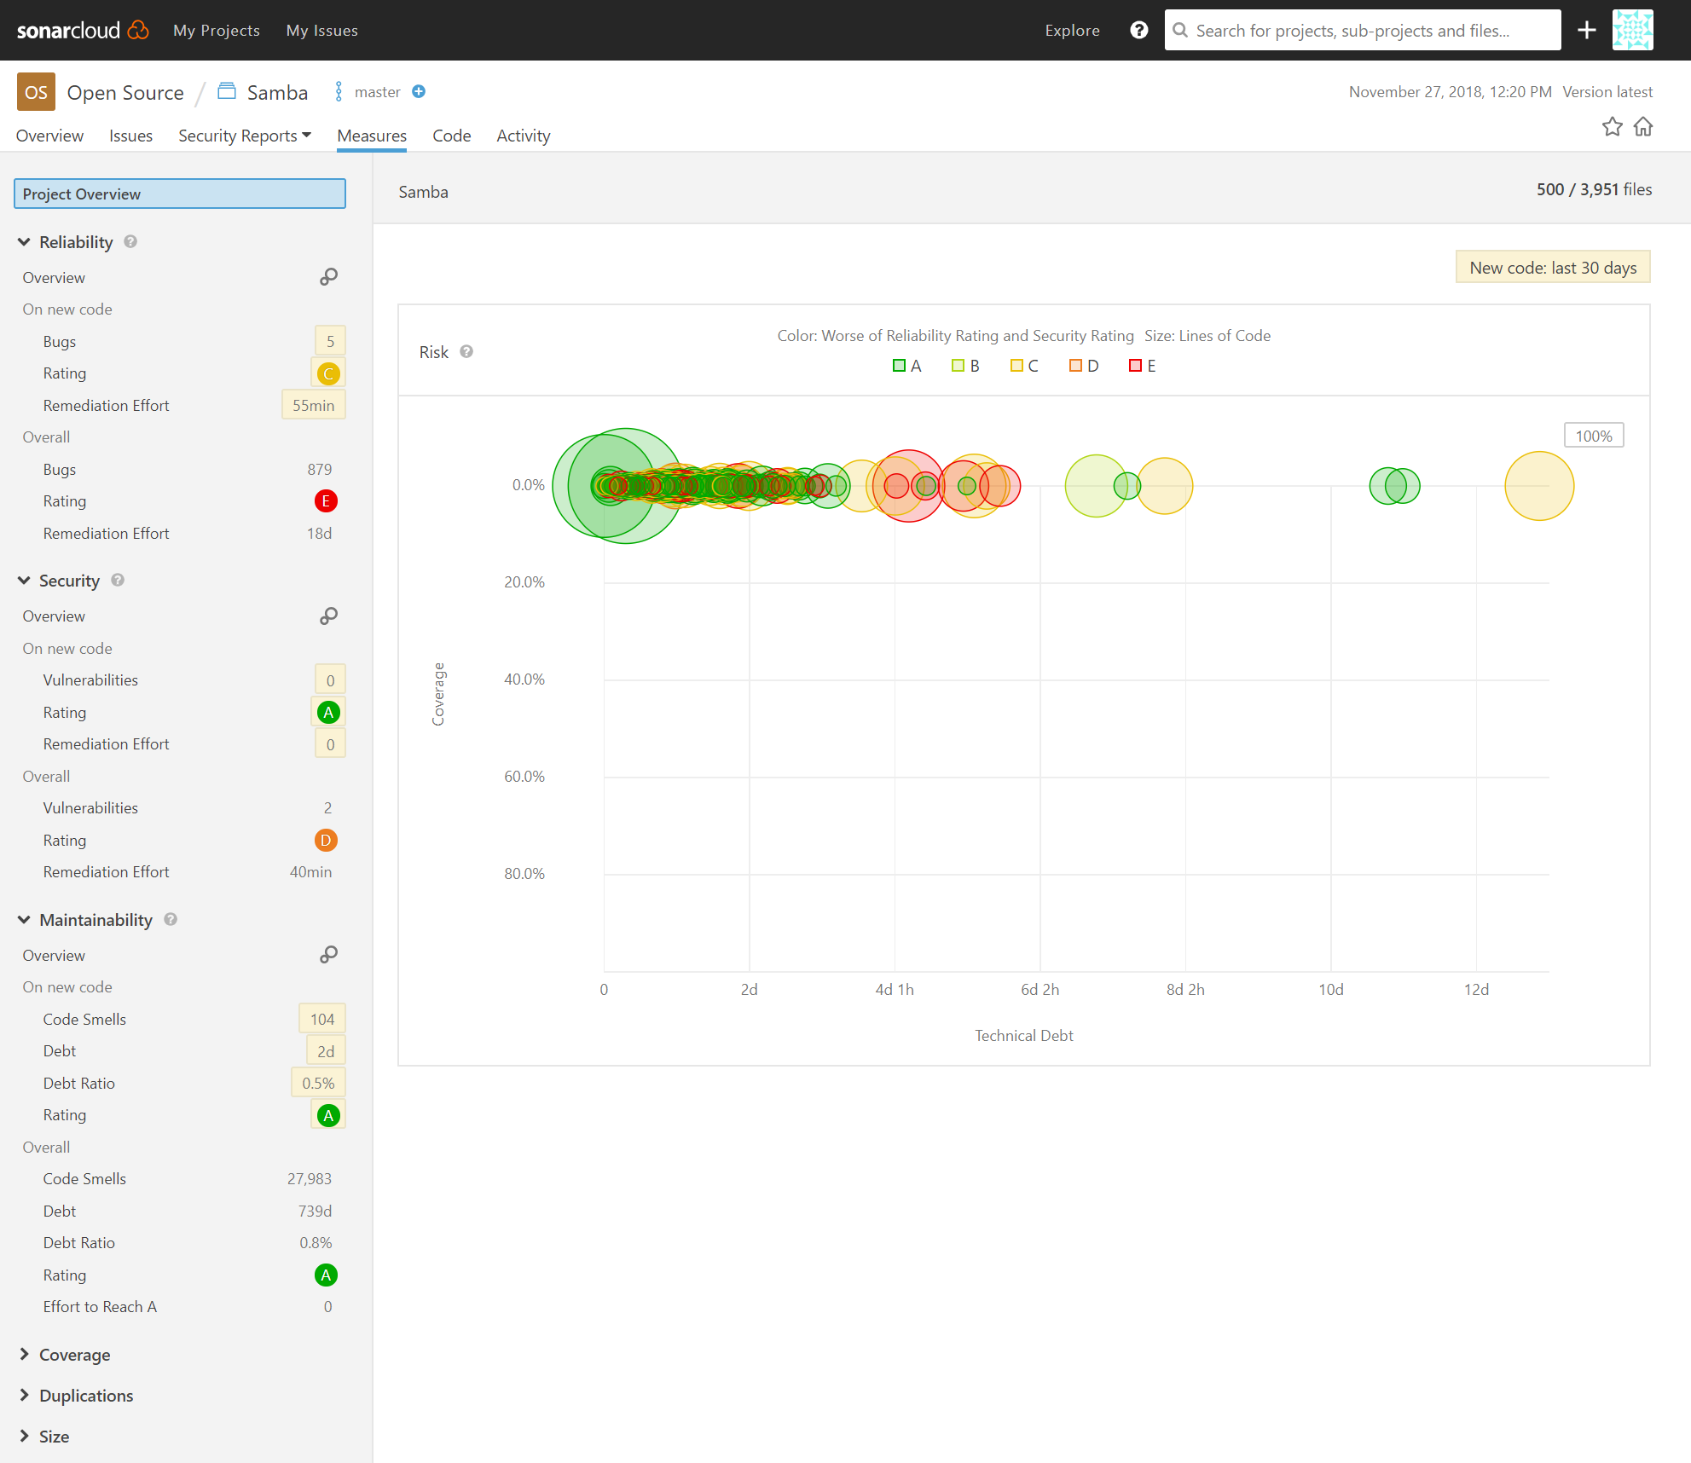

Slide 8
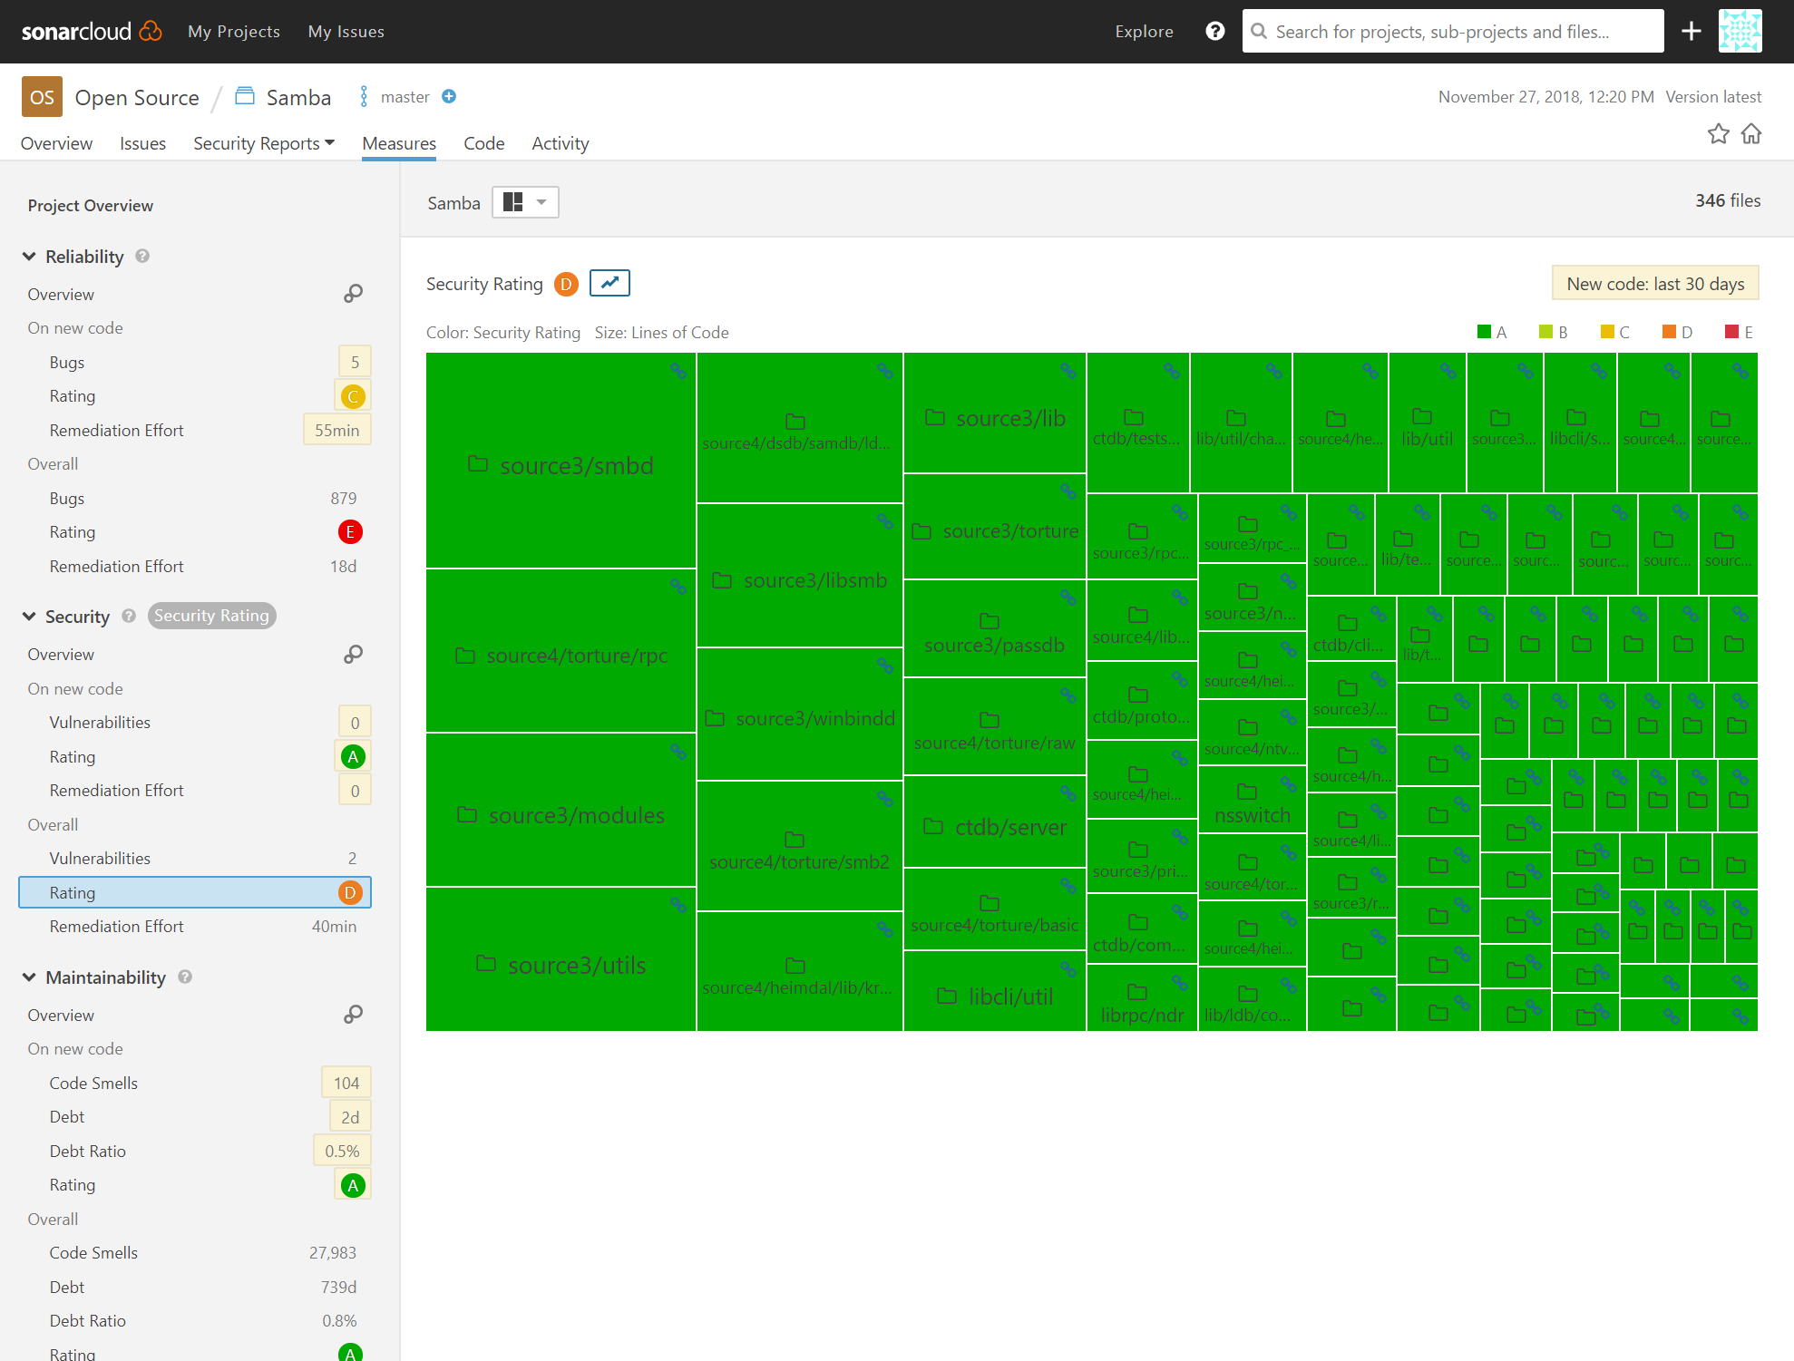

Slide 9
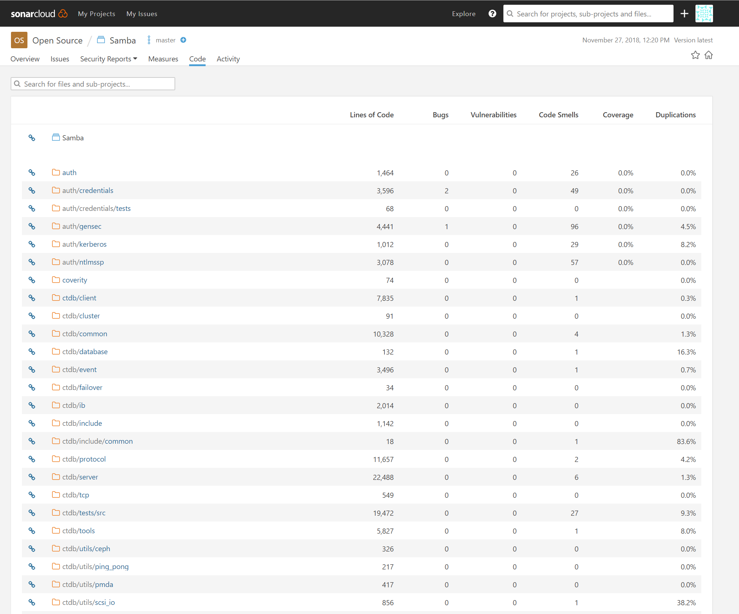

Slide 10
